Slide 1
A Comprehensive Data Analysis for Understanding Gun Violence in the United States
Student: Venu Sai Ram Udayabhaskara Reddy Koyya
Chandraprakash Reddy Kasarla
Professor: Dr.Gulhan Bizel & Dr.Sharath Kumar Jagannathan

Slide 2
Introduction
The Gun Violence dataset is a vital repository, offering deep insights into firearm-related incidents and their multifaceted nature. Its importance lies in illuminating the breadth, trends, and complexities of gun violence, thereby assisting stakeholders in areas like public safety, criminal justice, policy formulation, and advocacy efforts. With a wealth of details encompassing incident timing, locations, nature, casualties, law enforcement involvement, and contextual factors, it provides a comprehensive understanding of each event.
Given the sensitive nature of the topic, an approach grounded in accuracy, impartiality, and empathy is essential for analyzing the data respectfully and considering those impacted by gun violence. The dataset holds promise in raising public awareness, fostering community education, and enabling informed discussions, all crucial for evidence-based policymaking and interventions. Analysis spans various dimensions, including incident types, policy recommendations, geographical patterns, demographic profiles, and societal impacts, contributing to a holistic understanding of gun violence within the public health framework.

Slide 3
Problem Statement
How many cases have been registered in each state?
Compare gun violence incidents between urban (city) and rural (county) regions?
Determine whether there is a link among the existence of representative and either the severity or frequency of occurrences.
Determine whether demographics are particularly susceptible or prone to participating in such situations.
Determine whether cases using stolen guns differ from those involving legally owned guns.
Determine participant relation type in violent events particularly prone to gun violence.
Identify what ages are particularly engaged in these types of situations.
Find the overall amount of people murdered in each state.
Identify which age group plays the biggest part in this violence.
In which year did the most cases occur?
To find incident of gun violence over time?
Actual vs. Predicted incidents Plot by using K-Nearest Neighbors (KNN) and Random Forest model?
Future prediction of gun violence using time series analysis?

Slide 4
Data Collection
Open-source dataset “gunviolencearchive”.
Sources & Time Frame: GUN VIOLENCE ARCHIVE (2013-2018)
Data Types: Gun violence data with 239678 rows and 29 columns with variety of aspects of gun violence, including the number and distribution of incidents, the relationship with sociodemographic variables, its effect on groups, and the success of various prevention and intervention activities. It serves as the basis for policy development based on evidence, supporting legislators, academics, and activists in devising successful methods to reduce the negative societal effects of gun violence.

Slide 5
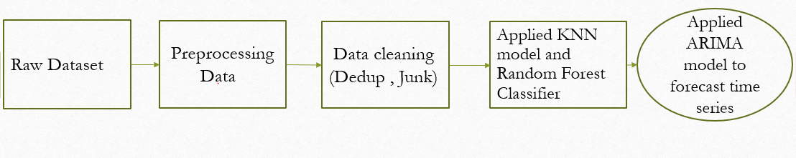
Methodology: Illustration of the Entire Model

Slide 6
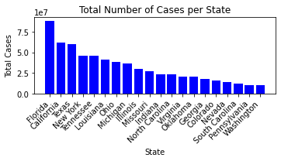
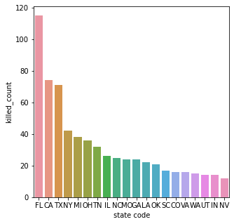
How many cases have been registered in each state and overall amount of people murdered in each state.
The analysis indicates Florida's significantly high number of incidents, notably in murder victims.
Florida emerges as the state with the highest count of murder victims among all states. These findings spotlight regional disparities in homicide rates, urging targeted interventions.
Understanding such geographical variations is crucial for effective crime prevention strategies.

Slide 7
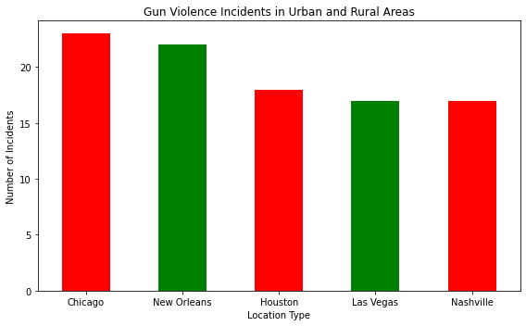
Compare gun violence incidents between urban (city) and rural (county) regions.
The analysis underscores the urgent need for tailored interventions and policy measures, particularly in high-risk urban settings like Chicago, to address the significant disparities in gun violence incidents.

Slide 8
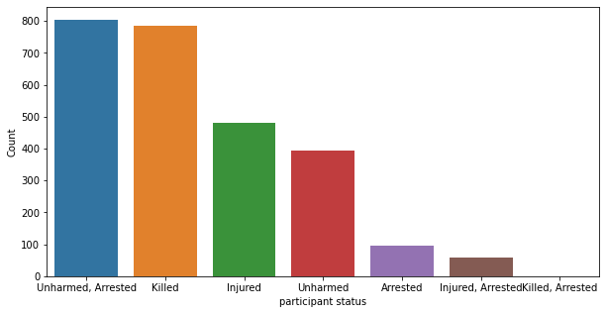
Determine whether there is a link among the existence of representative and either the severity or frequency of occurrences.
Preliminary analysis indicates a potential link between certain representatives involvement and the severity or frequency of gun violence incidents, suggesting a higher arrest rate in such cases. Further exploration is needed to validate and comprehend this correlation's underlying dynamics.

Slide 9
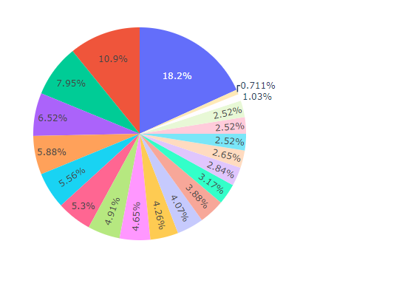
Determine whether demographics are particularly susceptible or prone to participating in such situations.
The results of the analysis indicate potential disparities in the involvement of specific demographic groups in incidents within institutional, group, or business contexts, warranting further investigation into underlying socio-economic and cultural factors.

Slide 10
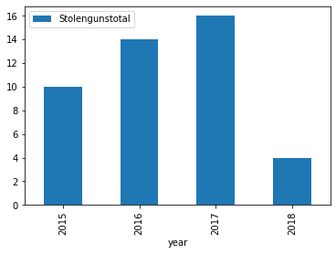
Determine whether cases using stolen guns differ from those involving legally owned guns.
The figure delineates disparities between gun violence incidents involving stolen and legally owned firearms in 2017, revealing potential differences in characteristics and outcomes. By focusing on firearm origin, it provides valuable insights into the varying dynamics of these incidents and their implications for policy and intervention strategies.

Slide 11
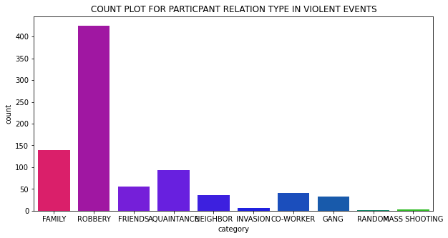
Determine participant relation type in violent events particularly prone to gun violence.
Robbery emerges as the predominant category in gun-related incidents, while analysis of participant relationships unveils underlying dynamics and motives, informing targeted prevention strategies.

Slide 12
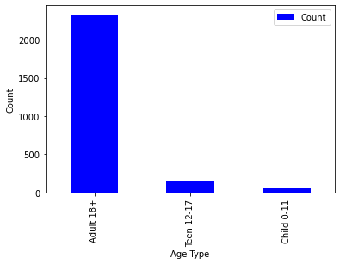
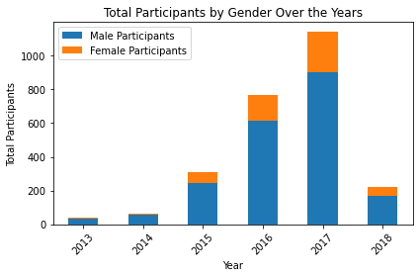
Identify what ages are particularly engaged in these types of situations and which age group plays the biggest part in this violence.
The analysis reveals that individuals aged 18 and older are predominantly involved in committing crimes, while other age groups also exhibit significant engagement in such violations.
Furthermore, upon further examination, it becomes apparent that the male age group plays a predominant role in perpetrating acts of violence.

Slide 13
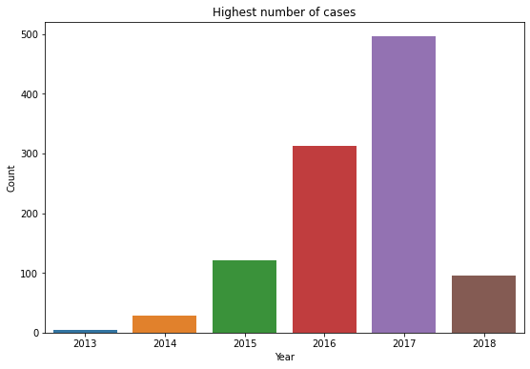
In which year did the most cases occur.
The analysis reveals that the year with the highest number of gun violence cases is 2017.

Slide 14
Methodology: K-Nearest Neighbors (KNN) and Random Forest:
K-Nearest Neighbors (KNN) :
K-Nearest Neighbors (KNN) is a non-parametric machine learning algorithm used for classification and regression tasks, where the prediction is based on the majority class or average of the k-nearest data points in the feature space.
Random Forest:
Random Forest is an ensemble learning technique that combines multiple decision trees to improve predictive accuracy, and it provides feature importance scores to identify the most influential features in the model's predictions.
Below are the features used in the analysis:
1. Number of Killed Individuals (n_killed):This feature represents the count of individuals who were fatally injured in the incident.
2. Number of Injured Individuals (n_injured): This feature denotes the count of individuals who sustained injuries during the incident but survived.
3. Congressional District (congressional_district): This feature indicates the congressional district where the gun violence incident occurred, providing geographical context to the data.
4. Latitude Coordinate (latitude): This feature represents the latitude coordinate of the incident location, enabling spatial analysis and visualization of incident distribution.
5. Longitude Coordinate (longitude): This feature denotes the longitude coordinate of the incident location, facilitating spatial analysis and mapping of incident occurrences.
6. Number of Guns Involved (n_guns_involved): This feature indicates the count of guns that were involved in the incident, providing insights into the scale and magnitude of the event.

Slide 15
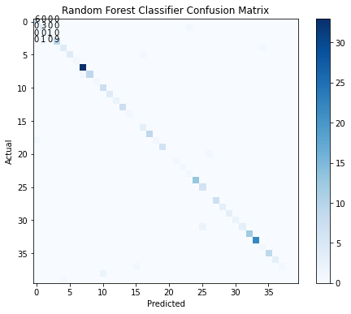
Actual vs Predicted for Random Forest
The Random Forest Classifier demonstrates high accuracy with a score of 0.93, evaluated against actual labels. A confusion matrix visually depicts the model's performance, detailing true positives, true negatives, false positives, and false negatives.
Crucial features such as casualties, congressional district, coordinates, and firearm quantity inform the classifier in predicting the state variable. This approach effectively constructs a predictive model by leveraging feature-based patterns learned by the Random Forest Classifier. Overall, rigorous evaluation ensures confidence in the model's accuracy and applicability.

Slide 16
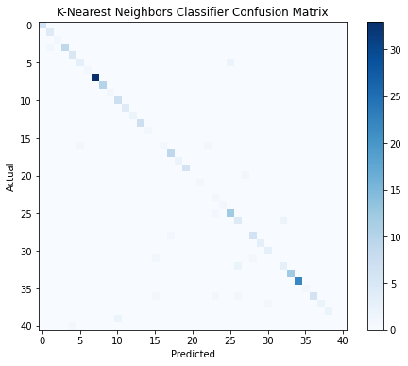
Actual vs Predicted for K-Nearest Neighbors (KNN)
In the K-Nearest Neighbors (KNN) model, the algorithm selects the k nearest neighbors from the training data for each test data point and predicts the majority class among these neighbors. With an accuracy score function, the model achieves a KNN Classifier Accuracy of 0.90.
Furthermore, a confusion matrix is created and plotted using Matplotlib to visualize the model's performance in predicting the state variable. Unlike the Random Forest model, which employs decision tree ensembles, KNN bases its predictions on data point similarities, providing an alternative classification approach.

Slide 17
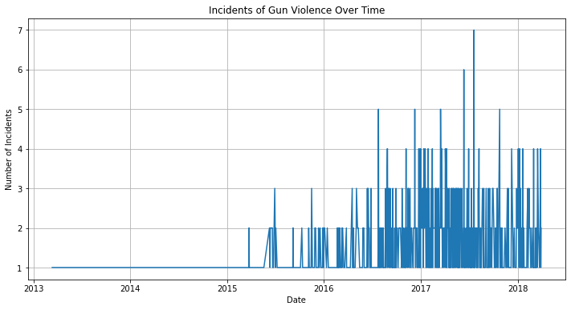
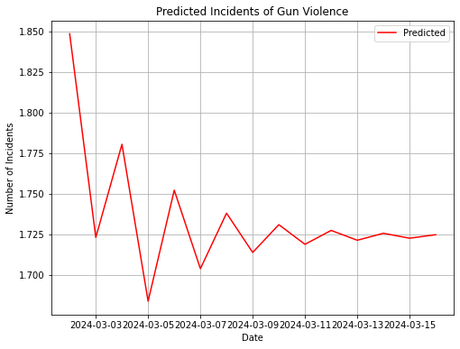
Graph showing existing data trend and future prediction of gun violence using time series analysis

Slide 18
Conclusion
Final Results –
The comprehensive analysis presented herein delves deep into the multifaceted landscape of gun violence incidents, unraveling regional dynamics, demographic susceptibilities, and the complex interplay of various contributing factors. Through a series of figures and findings, a nuanced understanding of gun violence emerges, shedding light on its intricate nature and profound impact on communities.
The figures presented, ranging from cumulative incident counts per state to temporal dynamics and predictive model accuracies, offer valuable insights into the spatial, temporal, and socio-demographic dimensions of gun violence. They highlight regional disparities, socio-economic influences, spatial nuances, and the implications of gun ownership and policy frameworks.
Future Scope –
Considering the findings, several avenues for future research and action emerge. Firstly, targeted interventions tailored to local contexts and socio-economic factors are warranted, considering the spatial nuances and regional disparities highlighted by the analysis. Secondly, there is a need for further exploration into the socio-demographic influences on gun violence, particularly in institutional settings, to inform more effective prevention and intervention strategies.
Additionally, ongoing monitoring and analysis of temporal trends and predictive model accuracies are crucial for staying abreast of evolving patterns and challenges in gun violence. Moreover, efforts to enhance data collection and reporting mechanisms, particularly regarding participant relationships within violent events and the temporal dynamics of incidents, can contribute to a more comprehensive understanding of the phenomenon.

Slide 19
References
A Literature Review and Research Agenda by J D Wright; P H Rossi; K Daly; E Weber-Burdin: Weapons, Crime, and Violence in America
Planty, Michael G., and Jennifer L. Truman. 2013 ,1993–2011: Firearm Violence.
Dewey Cornell - Gun Violence: Prediction, Prevention, and Policy
Alpers, P., & Wilson, M. (2013, August 14): Global impact of gun violence: Firearms, public health, and safety by
National Institute of Justice (NIJ): The research arm of the U.S. Department of Justice, NIJ funds studies and research initiatives related to gun violence and crime prevention.
American Academy of Pediatrics, Council on Injury, Violence, and Poison Prevention Executive Committee. (2012): Firearm-related injuries affecting the pediatric population.
FBI Uniform Crime Reporting (UCR) Program: The UCR Program collects and publishes data on crime, including firearm-related offenses, reported by law enforcement agencies across the country.
D. Webster & J. Vernick (Eds.): Gun control and homicide reduction.
Bandeira, A. R. (2013): Reducing gun violence in America: Informing policy with evidence and analysis (pp. 213–223).
The RAND Corporation: RAND publishes research on gun violence, including studies on the effectiveness of various interventions and policies aimed at reducing gun-related harm.
Borum, R., Cornell, D., Modzeleski, W., & Jimerson, S. R. (2010): What can be done about school shootings? A review of the evidence. Educational Researcher, 39, 27–37. doi:10.3102/0013189X09357620.
Guilford Press by Borum, R., & Verhaagen, D. (2006): Assessing and managing violence risk in juveniles. New York, NY.
Centers for Disease Control and Prevention (CDC): The CDC provides comprehensive data on gun-related injuries and fatalities through its National Violent Death Reporting System (NVDRS) and other surveillance programs.
The Pew Research Center: Pew conducts surveys and studies on public attitudes toward gun violence, gun ownership, and gun control policies.
Bostwick, J. M., & Pankratz, V. S: Affective disorders and suicide risk: A reexamination. American Journal of Psychiatry, 157(12), 1925–1932. doi: 10.1176/appi.ajp.157.12.1925.
National Crime Victimization Survey: Criminal victimization in the United States, 2006 statistical tables (NCJ 223436) by Bureau of Justice Statistics.
Bureau of Justice Statistics (BJS) - The BJS collects and publishes data on various aspects of crime, including firearm-related crimes, through surveys and reports.
Centers for Disease Control and Prevention: Source of firearms used by students in school-associated violent deaths — United States, 1992–1999. MMWR Morbidity and Mortality Weekly Report, 52(9), 169–172.
Gun Violence Archive (GVA): The GVA is an independent nonprofit organization that tracks gun-related incidents in the United States through media reports, law enforcement sources, and other sources.
Chapman, S., & Alpers, P. (2013): Gun-related deaths: How Australia stepped off “The American path.” Annals of Internal Medicine, 158(10), 770–771. doi:10.7326/0003-4819-158-10-201305210-00624. not put footnotes in the abstract or reference list. Use letters for table footnotes.

Slide 20
Thank you for your
attention!

